Slide 1


Small Business and Entrepreneurship Options for People With Disabilities
A three-part webinar series
Part one: Is Entrepreneurship for Me?
Presented by Bank of the West
Notes:
1

Slide 2
Housekeeping I: Captioning
If you wish to personalize the captioning:
We have sign language interpreters. You should be able to pin them to your screen.
Alternatively, Click the “Live Transcript” button on the Zoom panel to find the Hide Captions option,or adjust caption size under the “subtitle settings...” option.
Notes:
2

Slide 3

Housekeeping II: Questions
Content questions?
Click on the Q&A button and type in your question.
Tech support questions? Type your question in the Chat box.
Notes:
3

Slide 4
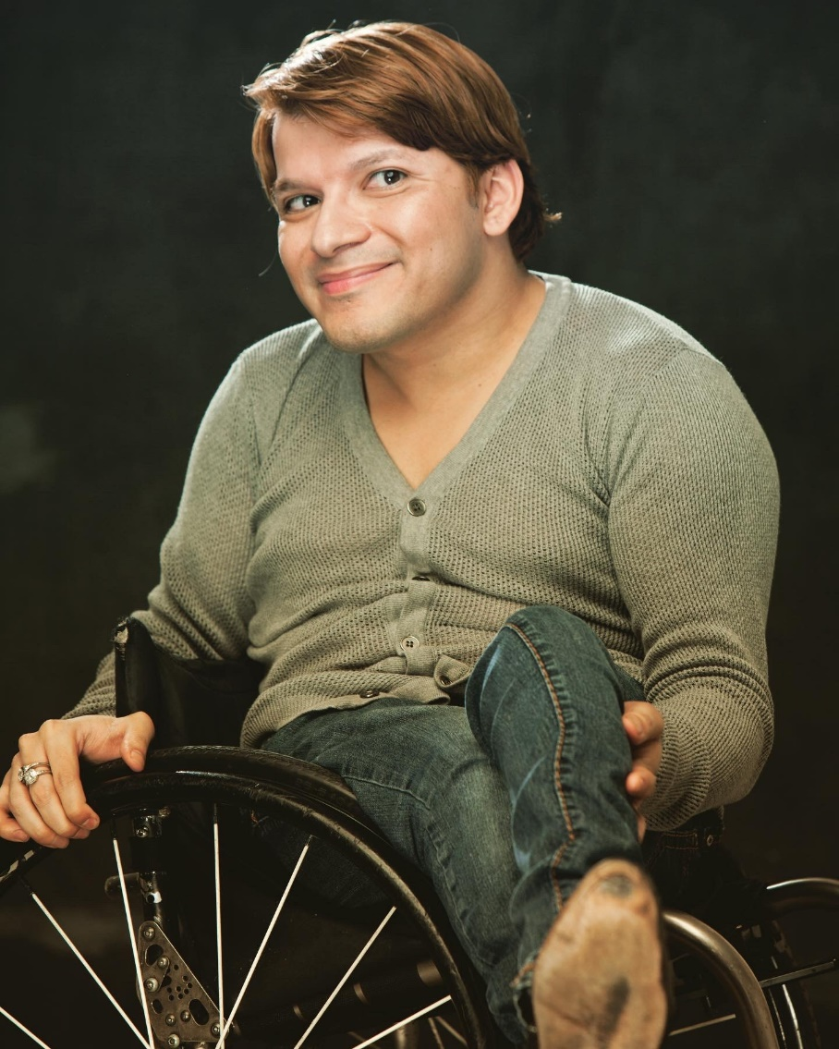
Welcome
Andy Arias DEIA & Policy Subject Matter Expert
Notes:
4

Slide 5

Learning Objectives
Participants will learn strategies to:
  What is self-employment?
  Who is doing it?
  Pros and Cons, what makes it attractive option for people with disabilities.
  Exploring your interests and goals (skills assessment tools).
  Panel of people with disabilities who started their own business or are an Entrepreneur, will share their experiences.
Notes:
5

Slide 6
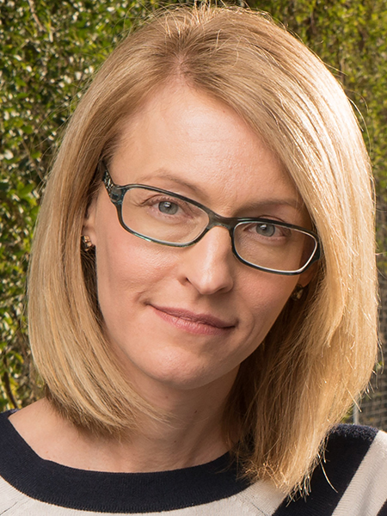
Ability 360 –Who We Are
April Reed, LMSW
Vice President of Advocacy
Notes:
6

Slide 7
Current Statistics
15% of the adult population have a disability.
74% of people with disabilities are not part of the labor force, 26% are Employed.
1.8 million are self-employed.
Data is incomplete as the Census Bureau and other major private sector data collection tools doesn’t ask respondents about disability.
Need a coordinated effort to collect the data on the number of small business owned by people with disabilities and their economic impact.
Notes:
7

Slide 8
New Study on Small Business Ownership by People with Disabilities
Published in April 2022 by the National Disability Institute (NDI).
Interviewed entrepreneurs with disabilities, and leaders in the eco-system of disability-owned business enterprises.
Access the NDI report at: https://www.nationaldisabilityinstitute.org/reports/small-business-ownership-pwd-challenges-and-opportunities/
Notes:
8

Slide 9
Type of Businesses
NDI study found that the businesses owned by people with disabilities were similar to those industries to people without disabilities.
  21% professional and business services
  16% construction services
  13% other
Notes:
9

Slide 10
Why They Are Choosing Self-Employment
Participants in the NDI study reported choosing entrepreneurship for a variety of reasons.
Creative opportunities.
Use disability experience and expertise to create a product or service.
Flexible schedule.
Control over work environment and accommodations.
Notes:
10

Slide 11
Challenges to Entrepreneurship and Small Business Ownership
Participants in the NDI study reported common challenges to entrepreneurship and business ownership.
Ableism
Accommodations
Concern regarding losing benefits.
Accessing financial resources and credit.
Networking
Notes:
11

Slide 12
Challenges- Ableism
Encountering Stereotypes
39% indicated that people believed that they do not have enough energy to run their own business due to having a disability.
16% indicated that they lost customers because customers preferred to work with individuals without disabilities.
Need to Challenge Stereotypes
58% of those survey indicated that their disability helped them in developing products and services that were unique, however 61% reported that they felt they needed to demonstrate superior knowledge in order to be taken seriously.
Notes:
12

Slide 13
Supports Utilized by Small Business Owners with Disabilities
40% of those surveyed indicated that they had utilized a mentorship program to support them in their small business development.
Many had utilized the Small Business Association Centers and SCORE Program.
These programs lack specific disability training or mentors with personal disability experience.
Notes:
13

Slide 14
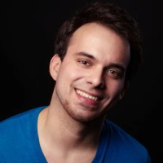
2Gether International
Diego Mariscal
Founder and CEO of 2Gether International
Notes:
14

Slide 15
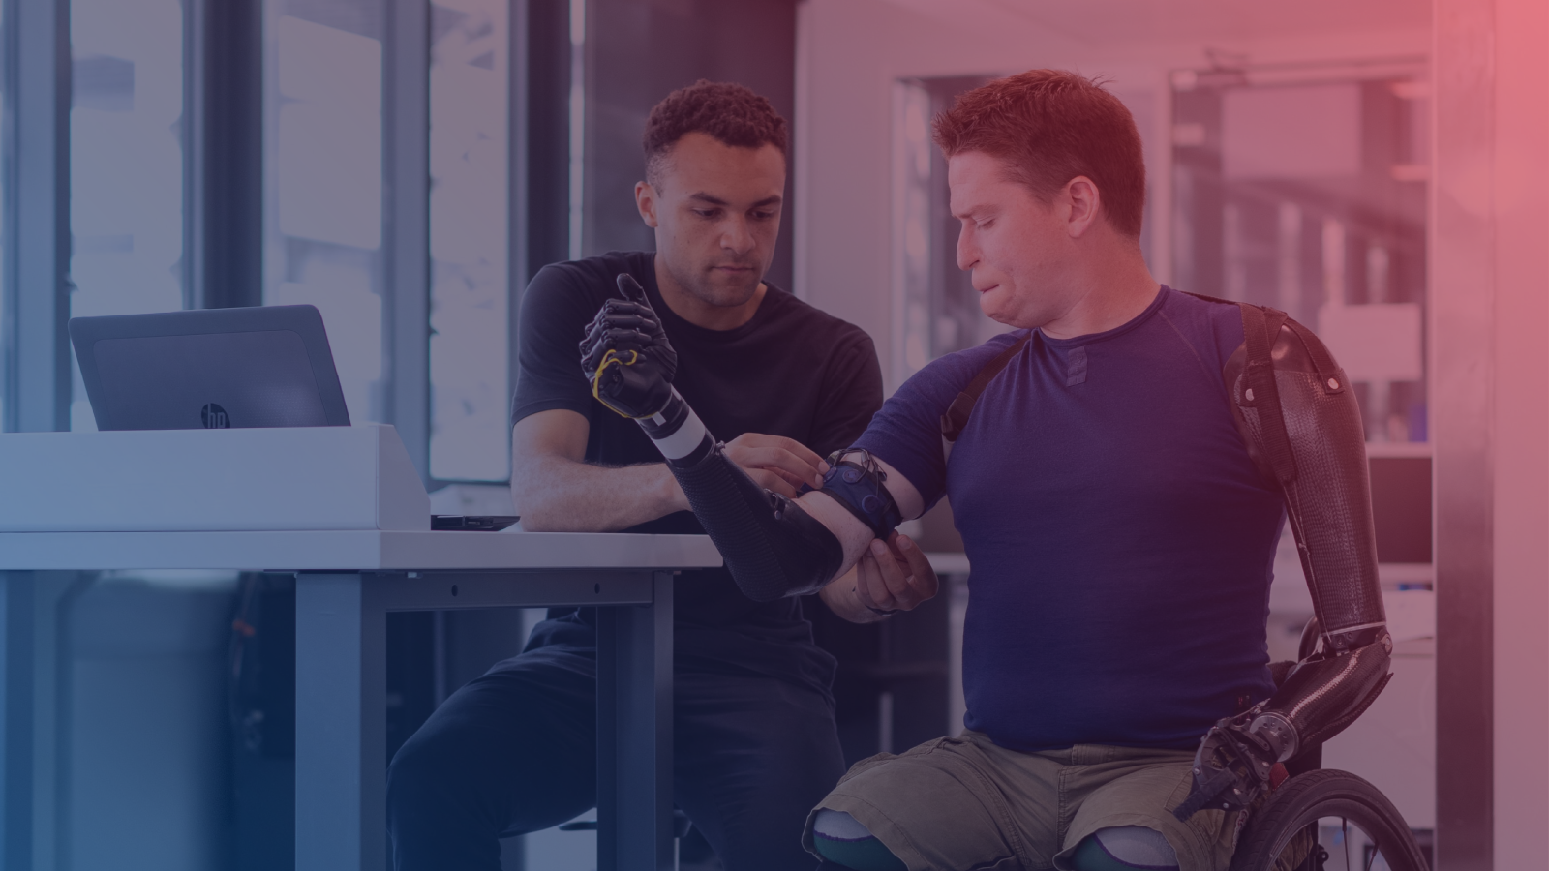

Leading Accelerator by and for Disabled Founders

Slide 16
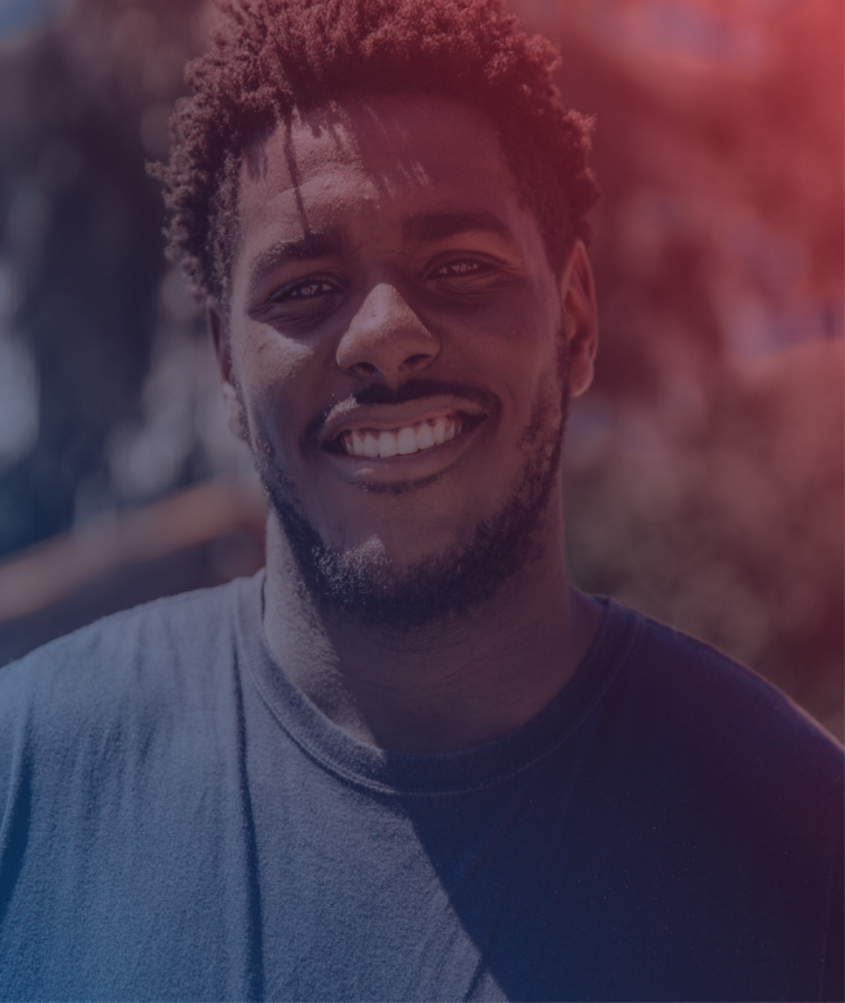
There is untapped potential of the largest startup minority group in the world….
Founders with Disabilities
1.3B people live with a disability. That’s roughly 15% of the world’s population.
People with disabilities are 2x as likely to be self-employed as those living without a disability.
$163 billion lost in annual tax revenue due to limited use of PwD in the workforce

Slide 17
We are one-of-a-kind
2Gether-International is the only startup accelerator in the world run by and for entrepreneurs with disabilities.

Slide 18

Why 2GI Over Other Accelerators
By and for entrepreneurs with disabilities
Focused on high impact high growth startups
National reach (600+ members, with over 35 states represented)*
Year long engagement
Aftercare high-touch individualized plan
Best Practices Report: How to best support founders with disabilities across accelerators
Public Policy Engagement
*Global reach also with 15 countries represented

Slide 19

A Unique Model Designed By & For Founders with Disabilities
Startup curriculum that’s universally designed and accessible
Peer-to-peer support
One-on-one accredited business coaching
Disability benefit resources and referrals
Access to the 2GI mentor network
Alumni network and programming
Investor intros and fundraising support

Slide 20
Target revenue of $5M-10 M in 5-10 years
Employment growth of at least 3x within 5 years with 51% disabled employees
Leadership in their sector with a goal of increasing media impressions and engagement at least 3x year over year
Technology implementation in their startup growth and sustainability strategy
Cohort Startup Profile

Slide 21



Google was deeply engaged with the 2GI Tech Cohort. They offered one-on-one mentorship from Googlers, branded storytelling and focus groups, a short film documentary, and we created a best practices playbook.
JPMC engaged with 2GI in creating the first ever online Venture Lab for founders with disabilities. This is an online community platform that engages FwD through self-paced modules and discussions.
Featured
Partners
ComcastNBCUniversal has been essential to the launch of our first ever BIPOC Cohort. Through our partnership we're able to host a cohort and connect BIPOC Founders with Disabilities to mentors, funding, and opportunities to grow their business.

Slide 22



KPMG is engaged with most of our cohorts in 2022. We are delivering opportunities for their in-house startups to learn from our founders, particularly around accessibility and inclusion.
With SBA support we launched our first DMV Disabled Founders Cohort in 2022, and look forward to uplifting the work of disabled entrepreneurs and small business owners in the DMV area for many years to come.
Featured
Partners
(Cont)
With the support of the Ewing Marion Kauffman Foundation we have been able to provide critical seed funding to Disabled Founders who win our Pitch Competition.

Slide 23



A Unique Model Designed By & For Founders with Disabilities:
We’ve built the LEADING US based startup accelerator focused on founders with disabilities.
In less than four years, 70 startups participated in our programs and went on to raise more than $41M from outside investors, acquisitions and revenue.
Accelerator Program:
Mar. July & Oct. 2023 Cohorts
5-10 Founders
10-week Program
Each cohort gets approximately 100s of applications. This allows us to focus on selecting only the founders who are the best fit for the program.
Over the course of 10-weeks we help founders grow their business and get them investor ready so they can raise post-program.

Slide 24
Media
Track
This track is built to support founders with disabilities working in the media space. This is the perfect track for sponsors looking to work with high-growth, high-impact startups building scalable ventures in the media space.
BIPOC Founder
Track
2GI is intentional about supporting underserved communities throughout all our programs. This track is the best way for you to help us on that mission and work with the best BIPOC founders with disabilities.
Accelerator
Tracks
Women Founder
Track
We’re committed to helping women founders with disabilities break into the traditionally male dominated startup world. Sponsor this track if you’d like to support and work with women founders building the businesses of tomorrow.
DMV Founder
Track
2GI is headquartered in the DC area, and we’re strong believers in investing in our community. This track is perfect for sponsors wanting to see an impact in the DMV area and support the founders building in their backyard.

Slide 25



The Venture Lab is a program built for pre-product, pre-revenue, and idea-stage companies. We support founders through an online content and a virtual community of startups at the same stage.
2GI Venture Lab
50-100 Founders
Self-Serve Content
Virtual Community
The Venture Lab is built to support five times as many founders as our flagship accelerator programs. This program will be the on-ramp for our accelerator programs.
Each week, founders can access new content to help them validate their ideas through customer discovery, sell their products, and prepare them for growth.
The founders will support each other via our online community. This network is perfect for bouncing ideas around and working through the challenges of validating an idea.

Slide 26
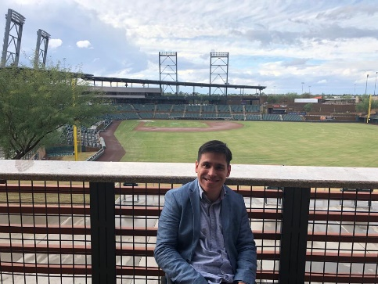
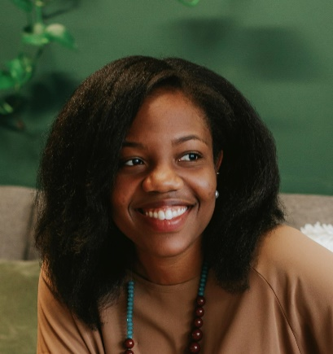
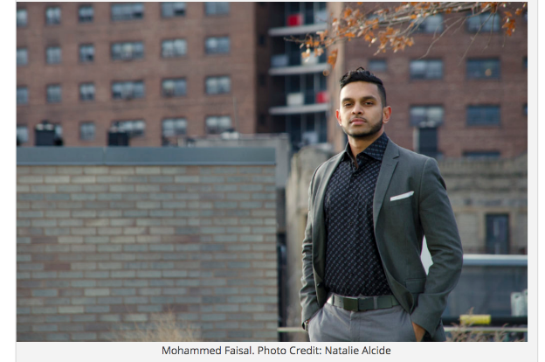
Entrepreneurship Panel
Victor Ocando Finol
Founder & CEO
Adapt the Game
Saïda Florexil
Co-founder | CEO
Imanyco
Mohammed Faisal Founder and CEO of The Money Hub
Notes:
26

Slide 27
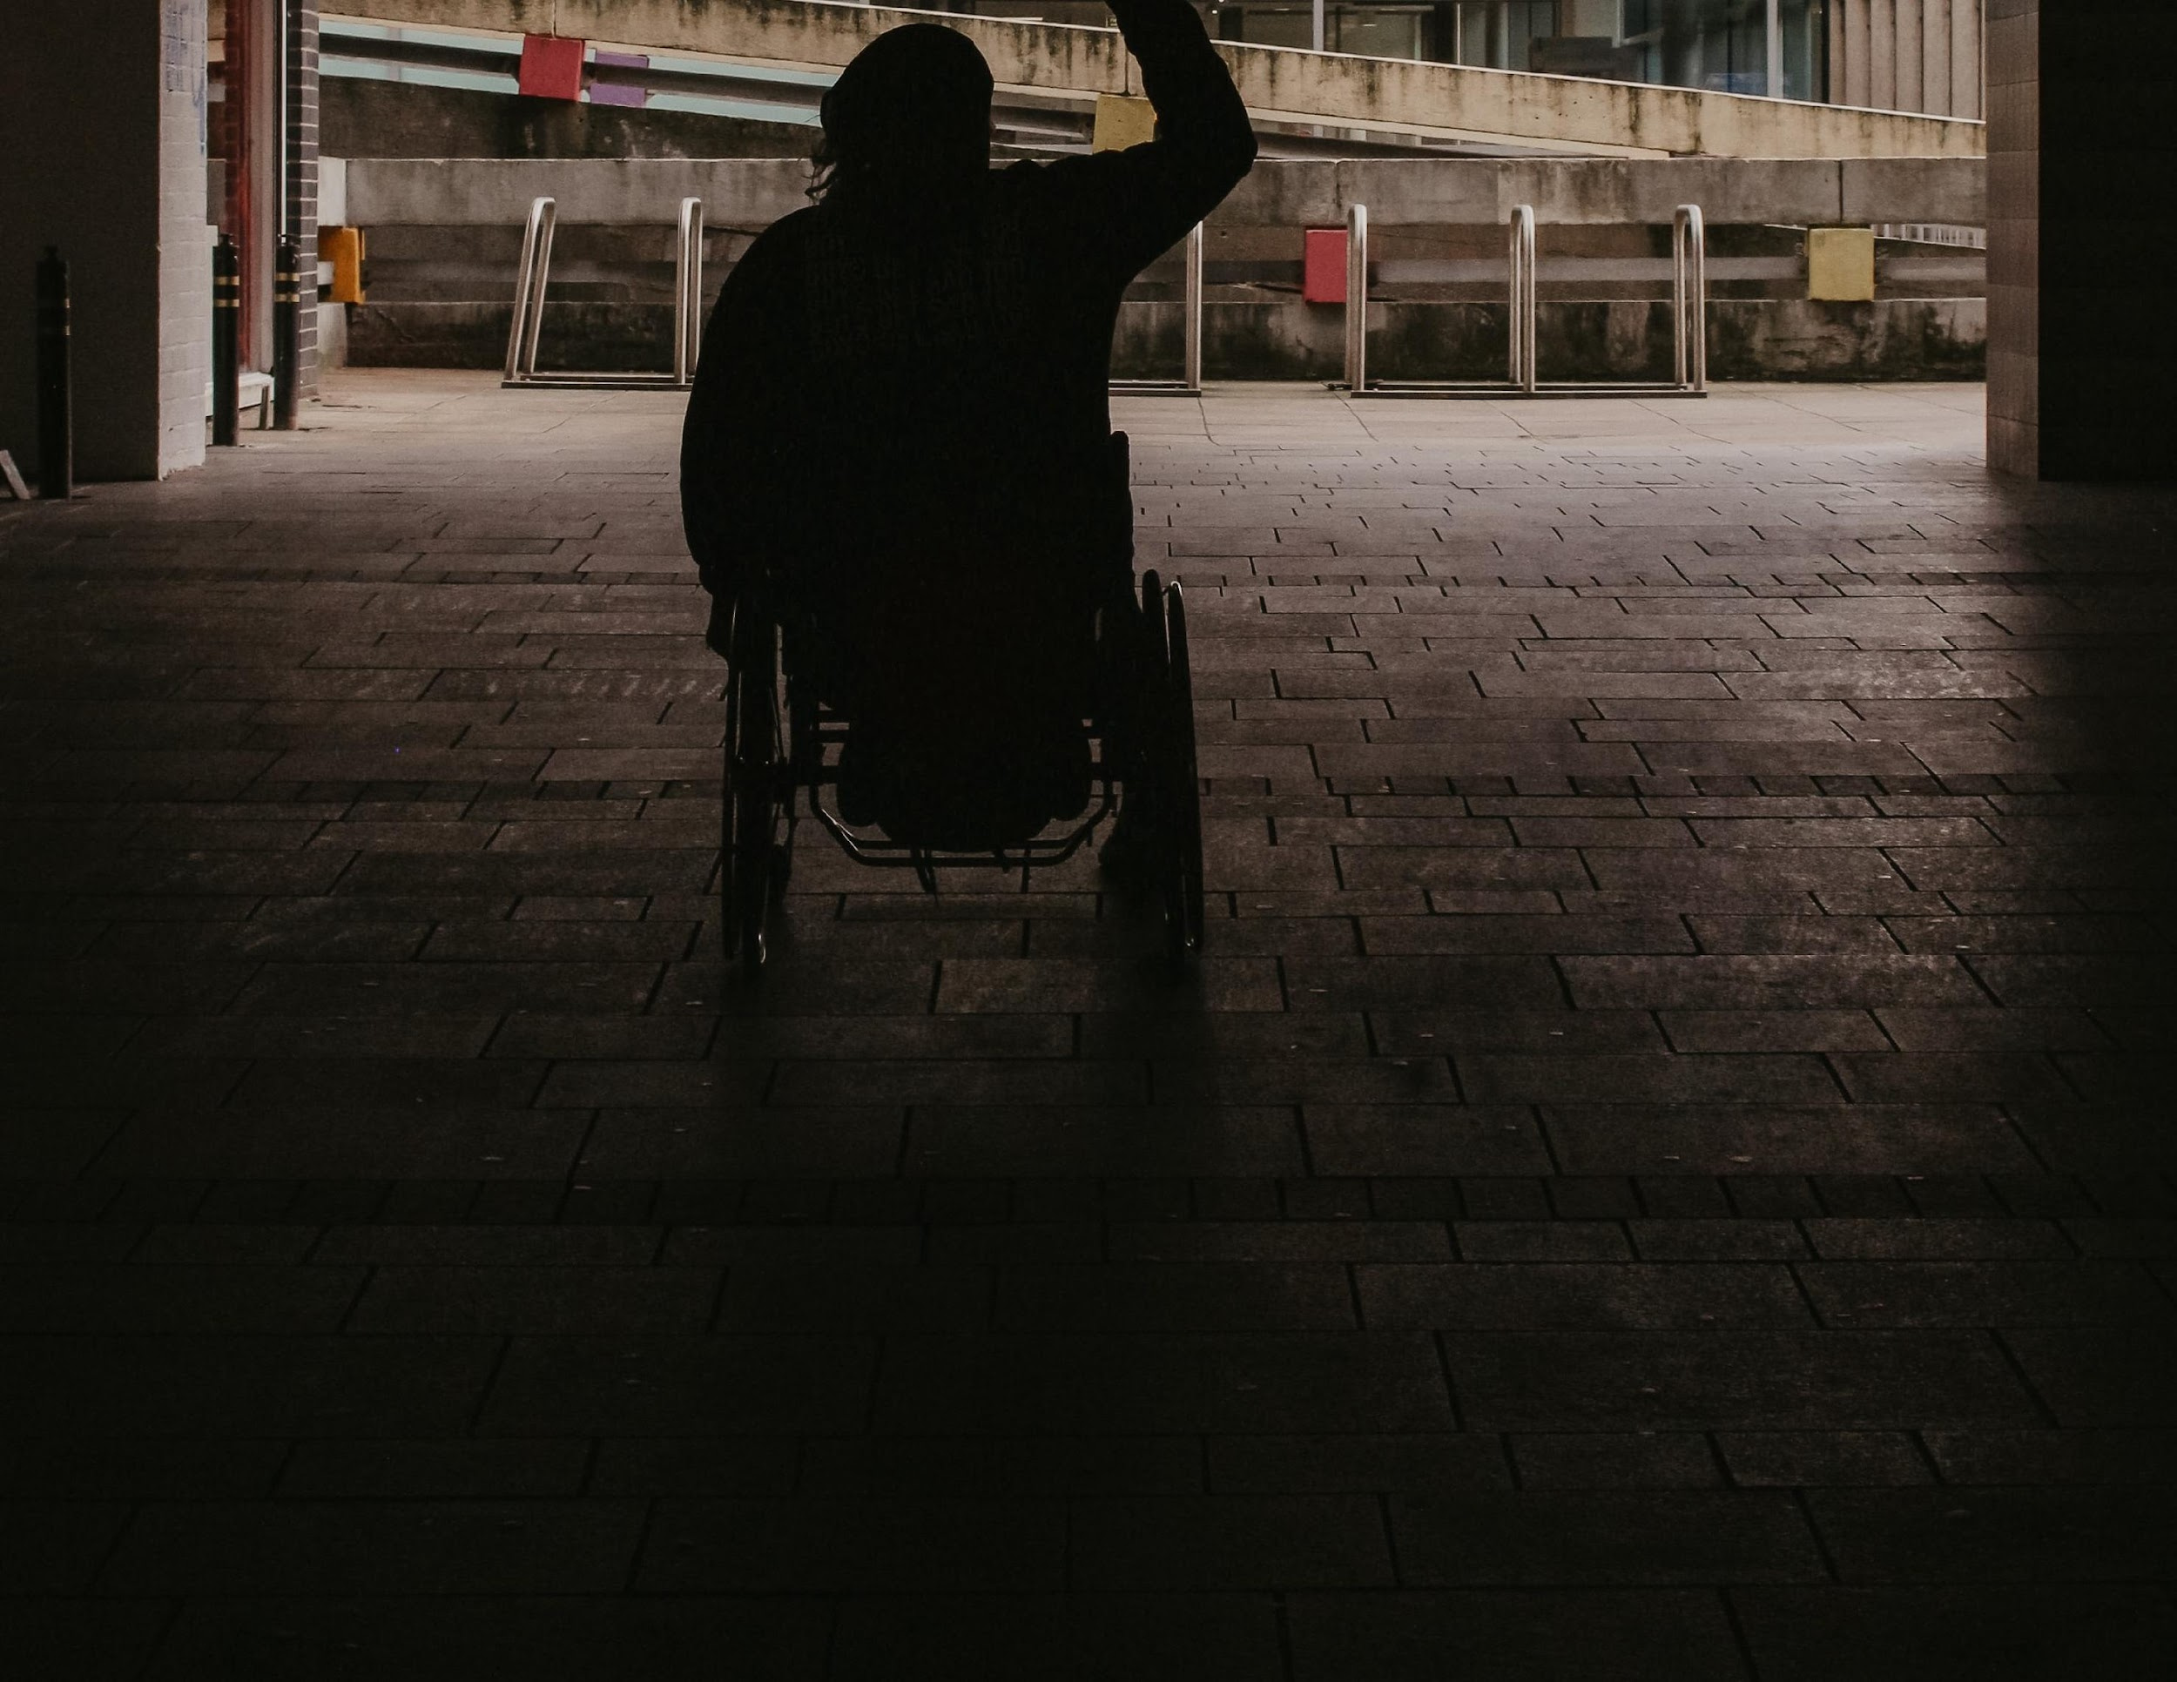

Slide 28

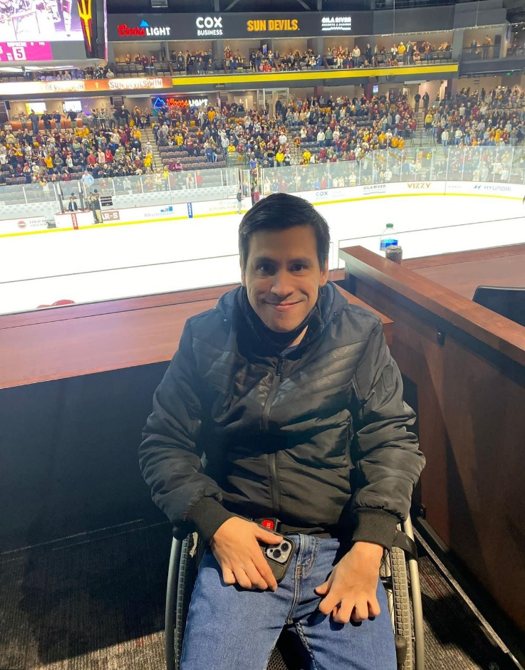
Founder
Victor Ocando Finol
CEO & Founder
I have experienced accessibility barriers in venues while attending live sporting events as a wheelchair user due to cerebral palsy since I was born.
Moreover, my professional background with over
8 years of experience working with different stakeholders and executives within the sports industry gives me an in-depth understanding of how this sector works. It also gives me the ability to align the needs of sports properties with those of the community of persons with disabilities.

Slide 29

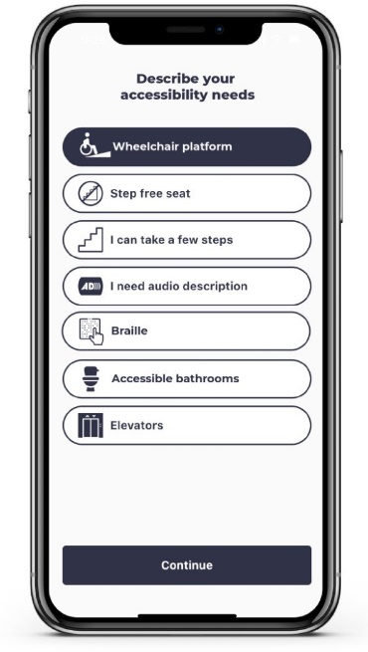
Problem
Problem/Solution
15% of the world population have a disability
7.5% can attend entertainment
events due to accessibility barriers
Source: Centre for Access to Football in Europe (2020)
8 of each 10 interviewed persons with disabilities face accessibility barriers
7 of each 10 struggle using ticketing platforms.
Source: Adapt the Game (2022)
S
A mobile app that enables fans with disabilities to easily obtain information about accessible venues and ticketing.
With our app you will be able to:
Create a fan accessibility profile
Notify venue upon arrival
Find the best seat available according to your accessibility needs
Share your game day experience
Find a companion
Get your tickets.

Slide 30

We seek to normalize access to sporting events for fans that have been ignored.
Our vision is for all fans to be able to live their passion for
the game equally.

Slide 31
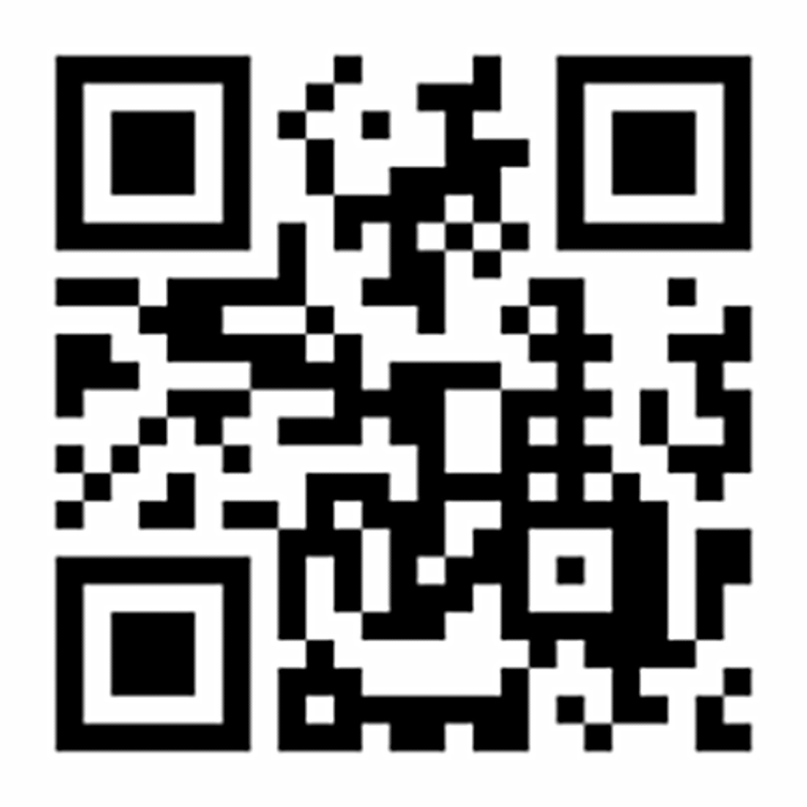
For More Information

Slide 32
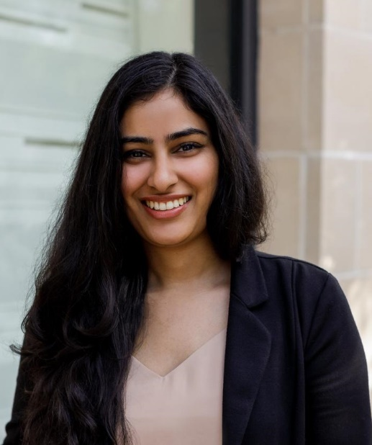


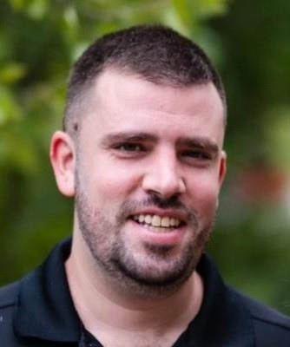
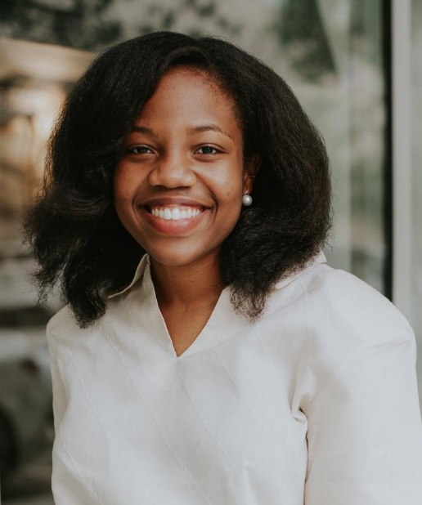

Slide 33
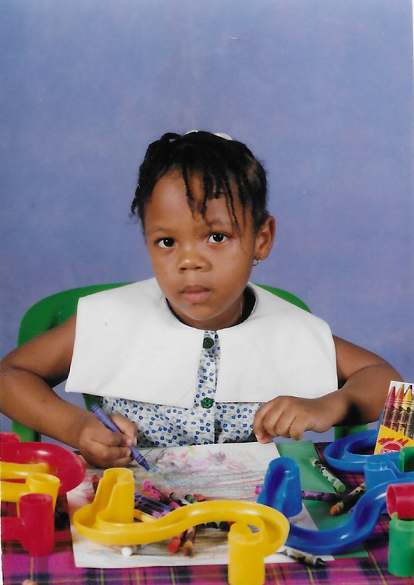

Slide 34


Slide 35
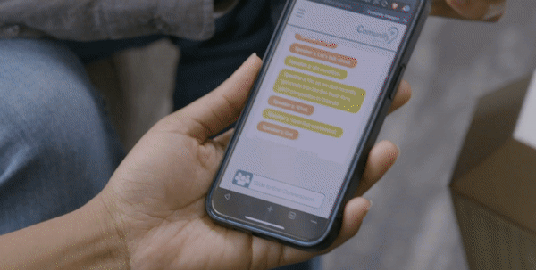

Slide 36
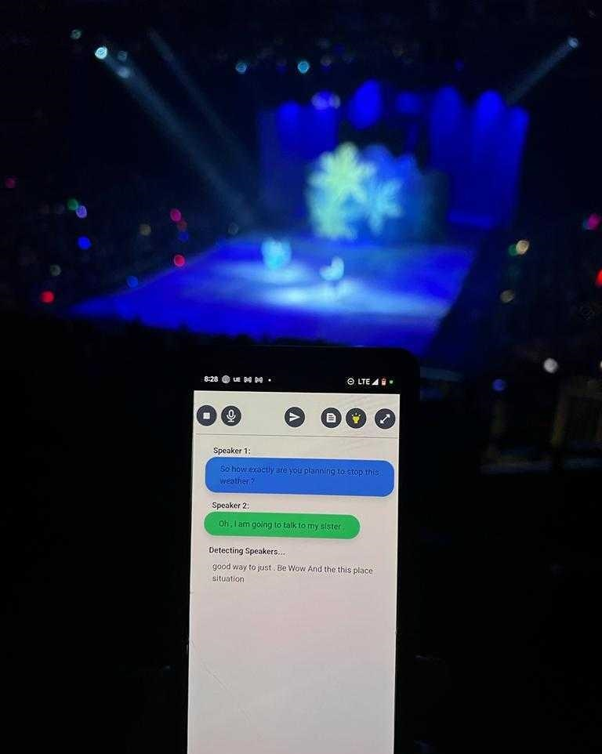
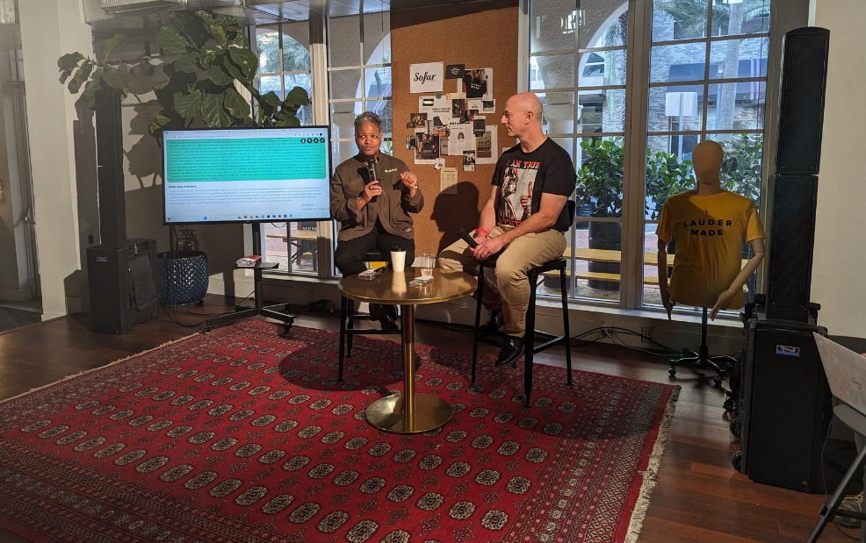
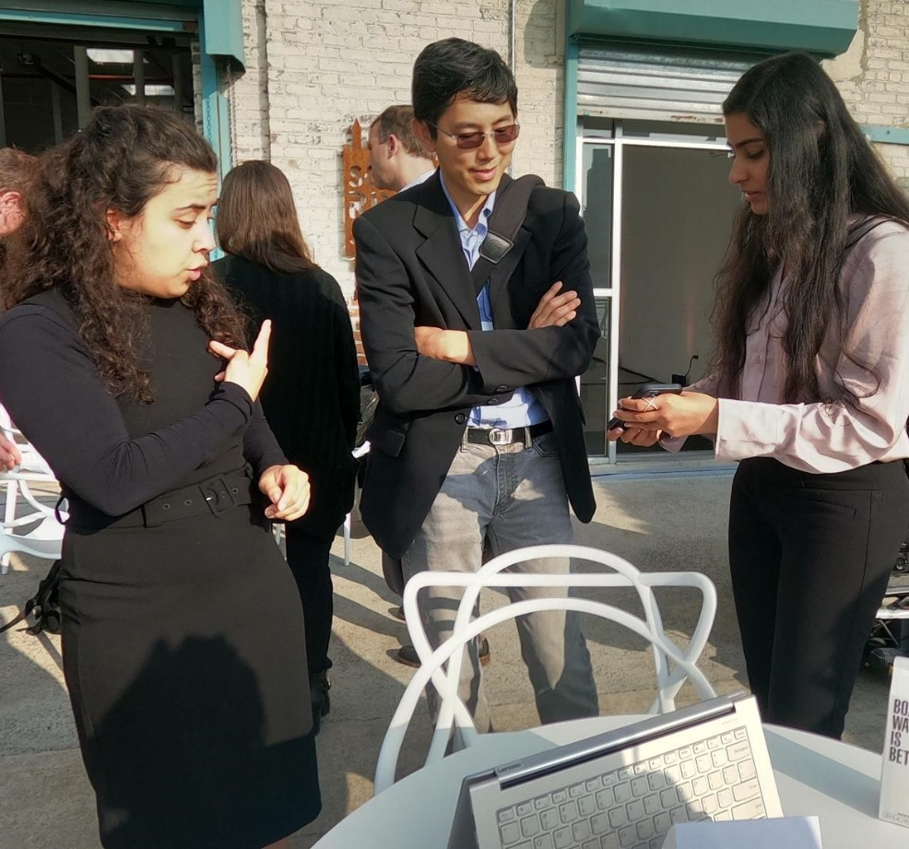

Slide 37
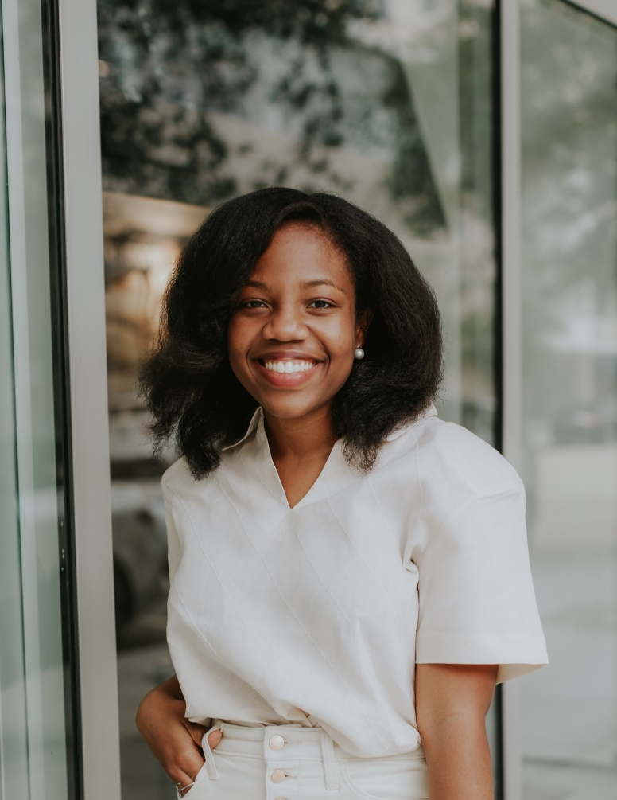
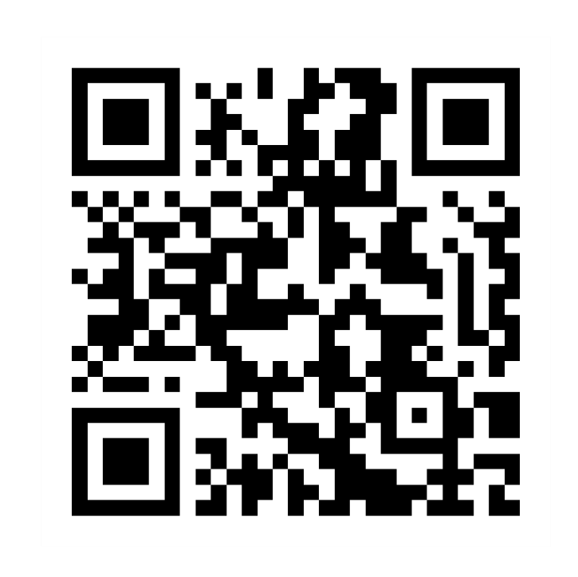
Contact information

Slide 38
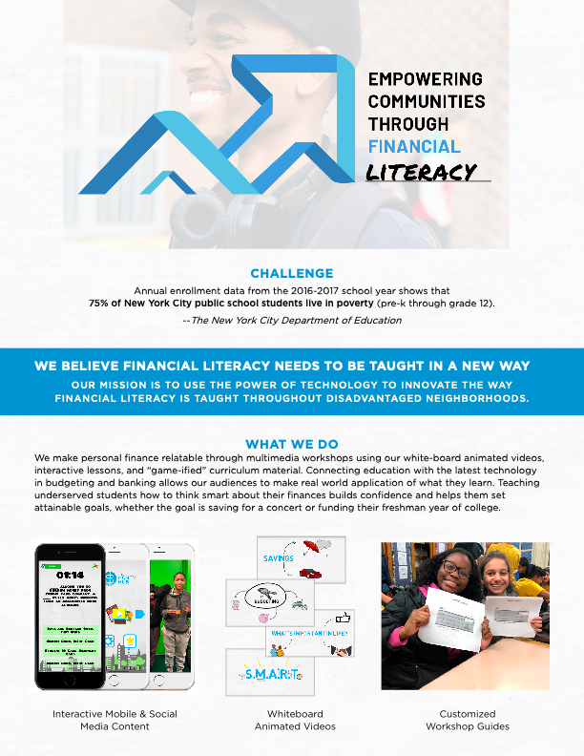

Slide 39
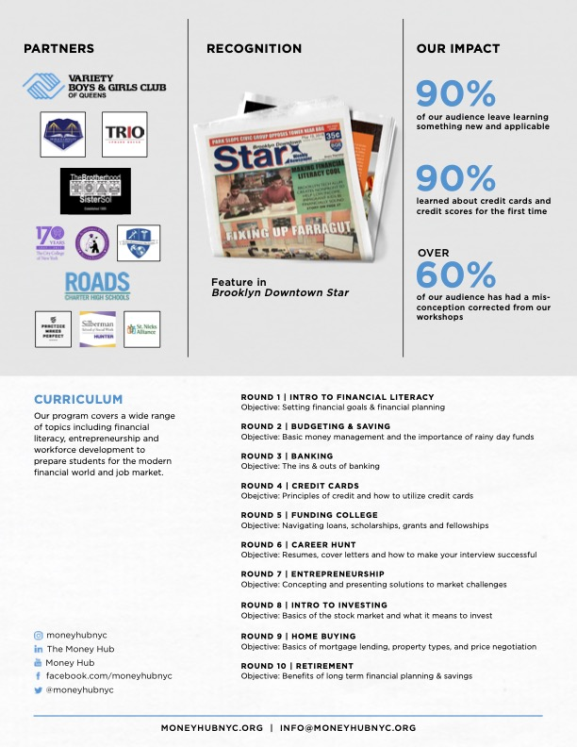

Slide 40
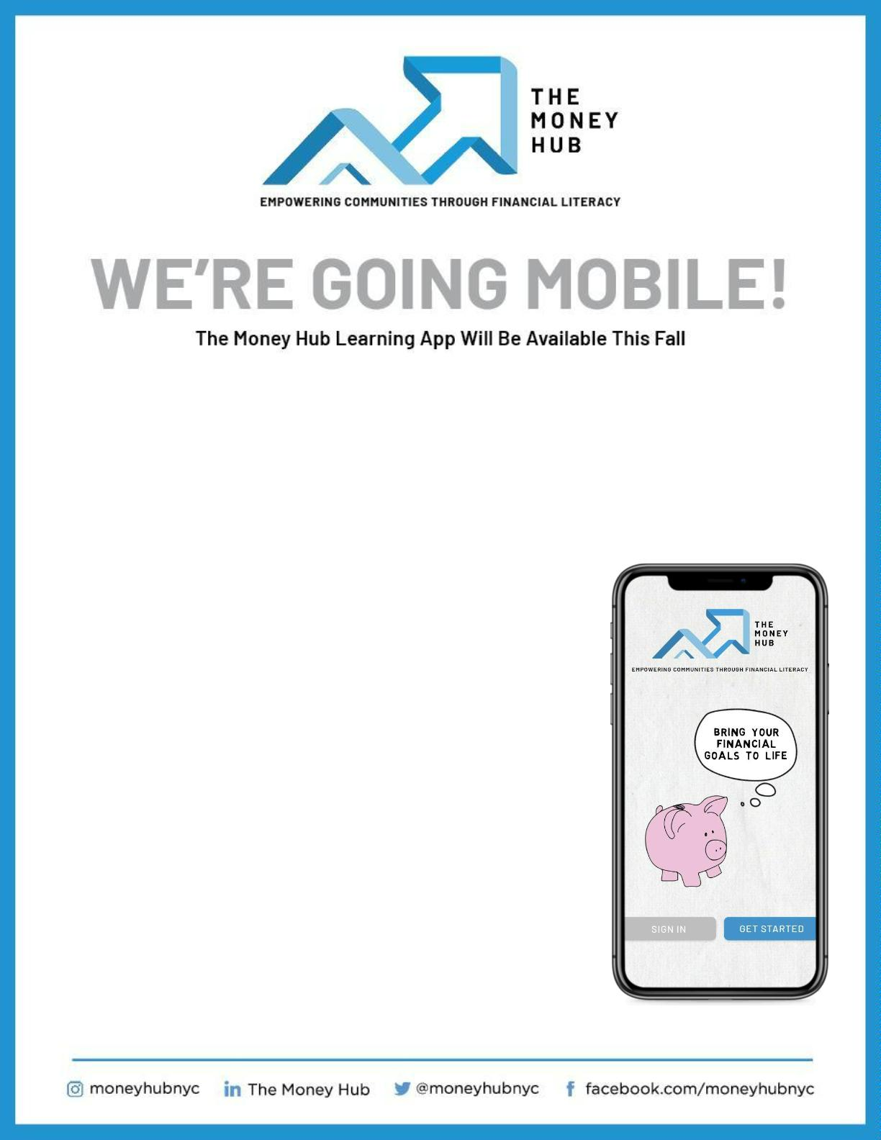
The Money Hub education app goes beyond the typical e-learning experience, engaging
students around ﬁnancial literacy topics through games and challenges. Our app is
designed for students to learn at their own pace and rewards progress with points and
badges as students make their way through the curriculum.
The Money Hub app will be available on desktop and mobile for easy access.
THE BREAKDOWN
Through a series of interactive lessons, students will
explore a vast range of topics including the basics of
savings, investing, resumes, cover letters, banking,
credit, and much more!
As students progress to each level, our curriculum
delves deeper into each topic. The leaderboard
enables students to track progress in real time while
competing with other students in their class for real
incentives like Amazon gift cards!
Each subscription provides educators with an
account where they can track the progress of
their students and see where they are excelling
or in need of improvement.

Slide 41
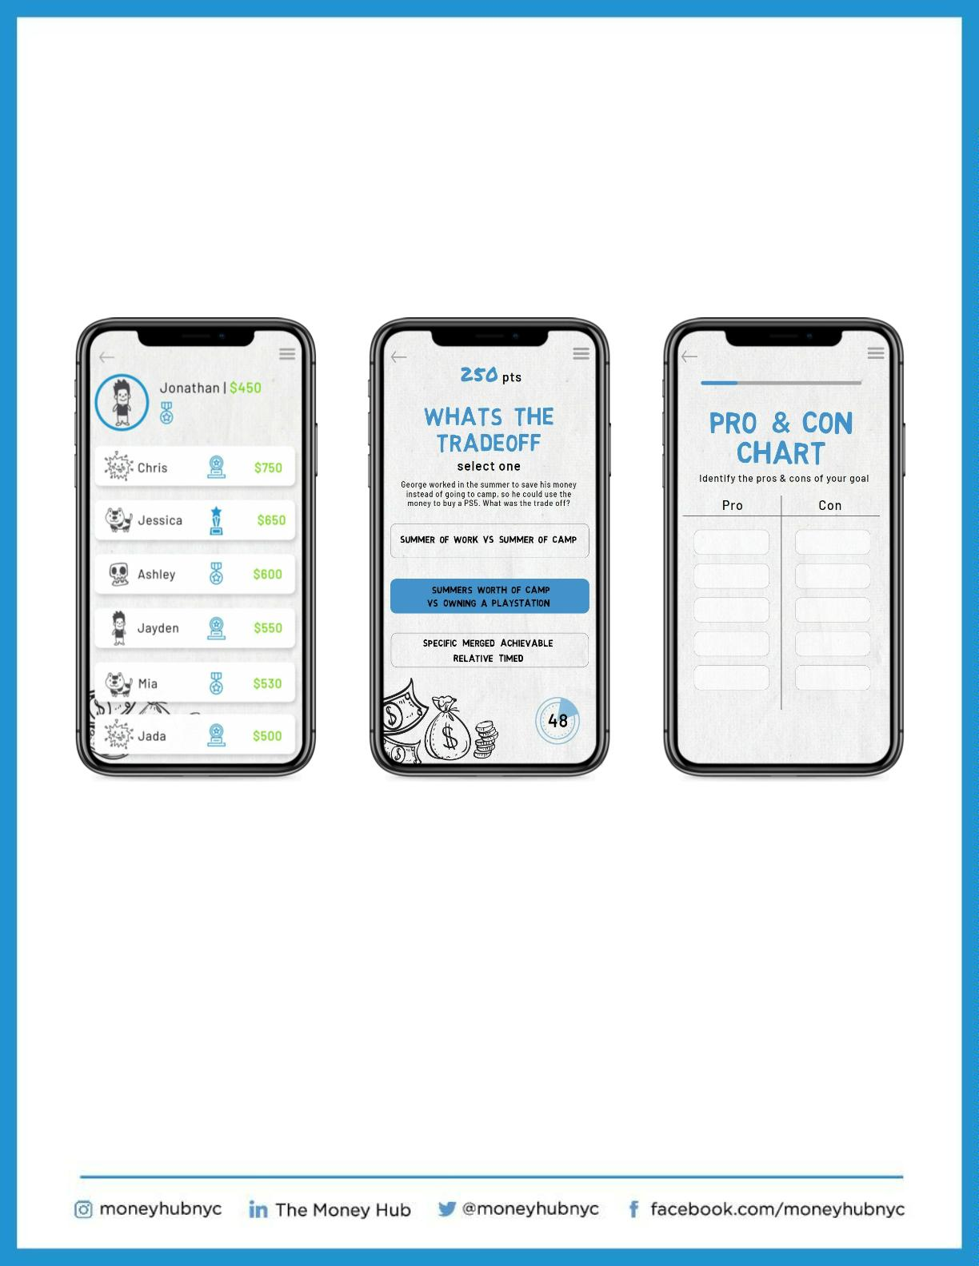
The purchase of a subscription unlocks access to resources even beyond
the period of license, allowing your students continued access to
budgeting resources and exclusive video content from our partners.
We’re currently establishing a banking partnership with ﬁnancial
institutions to offer direct in-app access to open a savings account.
The leaderboard gives
students the opportunity
to track their progress
while challenging peers.
Interactive content helps
students learn while having
fun and staying engaged.
Students will engage in
activities that they can
store in-app for future use.
For more information on our workshops and curriculum
contact Mohammed at faisal@moneyhubnyc.org

Slide 42
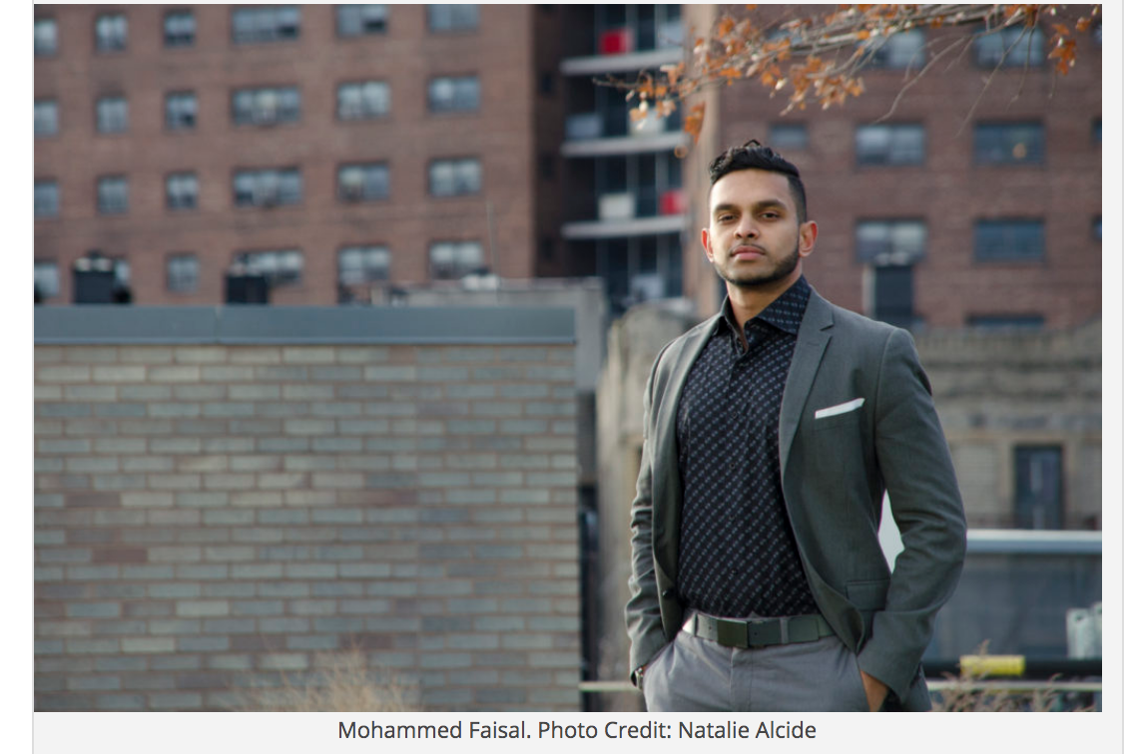
Additional video Content
https://www.youtube.com/watch?v=tPSQ_hqP8kM
https://www.youtube.com/watch?v=H9BZqOZlxus
https://www.youtube.com/watch?v=Bry3ieUc290
https://www.youtube.com/watch?v=Viucb718Gx4
Mohammed Faisal
Notes:
42

Slide 43

Questions and Answers
Notes:
43

Slide 44
Resources
2Gether-International
https://www.2gether-international.org/
Disability small business start-up and accelerator program, holds virtual peer-to-peer support group meetings, workshops and career coaching while offering one-to-one mentoring opportunities and referral services to support entrepreneurs with disabilities. Visit website for application requirements.
Arizona@Work
https://arizonaatwork.com/
Arizona’s American Job Center has no-cost employment readiness services.
From their website you can research job market trends, wages by occupation, and other analytics to inform your business plan development.
Notes:
44

Slide 45
Resources
Job Accommodation Network JAN consultants handle inquiries related to self-employment and small business development for people with disabilities. This includes referrals regarding business planning, financing strategies, marketing research, disability-specific programs, income supports and benefits planning, e-commerce, independent contracting, home-based business options, and small business initiatives for disabled veterans.
https://askjan.org/topics/Entrepreneurship.cfm
U.S. Small Business Administration https://www.sba.gov/business-guide
10 Steps to Starting Your Small Business Guide
Information on business plans, funding suggestions etc.
Notes:
45

Slide 46
Resources
Phoenix Women Business Center
https://phoenixwbc.org/
Provide counseling, training, business assistance and access to capital for women looking to grow or start their company.
Greater Phoenix SCORE
https://greaterphoenix.score.org/
On Demand Training, in person and virtual webinars, and access to mentorship to support in development of a business plan and starting a small business.
Arizona Small Business Development Center
https://azsbdc.net/how-we-help/
Ongoing resources and training for small business.
Notes:
46

Slide 47
Resources
DreamBuilder
www.dreambuilder.org
Free online learning program developed for women who want to start or grow their own business.
National Center for Disability Entrepreneurship
https://www.viscardicenter.org/entrepreneurship/
Program with curriculum for any person with a disability looking to launch or expand a business. Visit website to see if accepting new applications.
Disability Small Business Hub
https://www.disabilitysmallbusiness.org/
A collaboration between the National Disability Institute and the U.S. Small Business Administration. Provides current resources, podcasts, trainings, and events to start, build, and grow your small business.
Notes:
47

Slide 48
Resources
Securing Your Financial Future Toolkit www.dol.gov/agencies/ebsa/secure-your-financial-future The Securing Your Financial Future Toolkit was developed by U.S. Department of Labor’s Office of Disability Employment Policy (ODEP) and Employee Benefits Security Administration (EBSA). It’s a guide for people with disabilities who strive to obtain or maintain employment and achieve financial stability.
National Center for Disability Entrepreneurship
https://www.viscardicenter.org/entrepreneurship/
Program with curriculum for any person with a disability looking to launch or expand a business. Visit website to see if accepting new applications.
Notes:
48

Slide 49

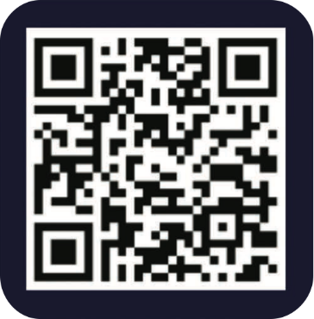
Use the QR code below to register for our next two webinars on March 18 and 25:
Reach out to Ability360 or any of our presenters with follow-up questions.
Notes:
49

