Slide 1

Small Business and Entrepreneurship Options for People With Disabilities
A three-part webinar series
Part Two: An Introduction to Small Business and Entrepreneurship
Presented by Bank of the West
Notes:
1

Slide 2
Housekeeping I: Captioning
If you wish to personalize the captioning:
We have sign language interpreters. You should be able to pin them to your screen.
Alternatively, Click the “Live Transcript” button on the Zoom panel to find the Hide Captions option or adjust caption size under the “subtitle settings...” option.
Notes:
2

Slide 3

Housekeeping II: Questions
Content questions?
Click on the chat button and type in your question.
Tech support questions? Type your question in the Chat box.
Notes:
3

Slide 4
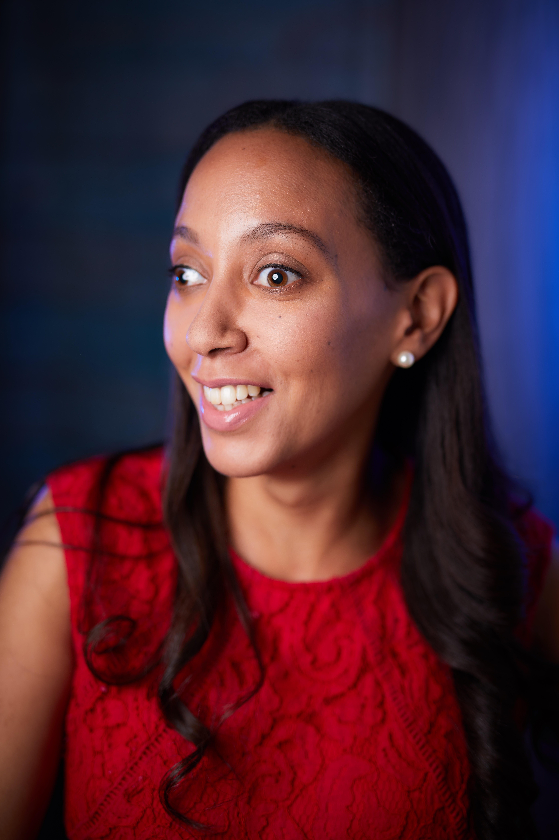

Welcome
Haben Girma Civil Rights Lawyer/ Author
Notes:
4

Slide 5

Learning Objectives
Participants will learn strategies to:
  How to start a small business plan, key components of a small business plan.
  Challenges to creating the business plan.
  Resources to help you to start writing a small business plan (SCORE, etc).
  Panel of people with disabilities who started their own business will share their experiences.
Notes:
5

Slide 6
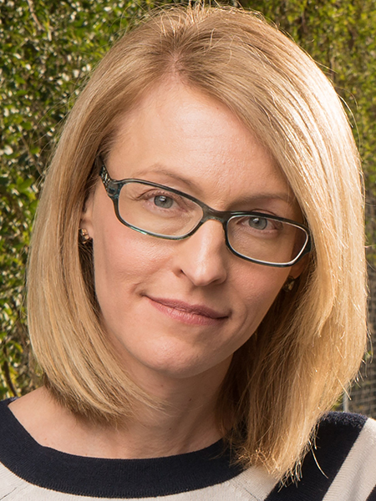
Ability 360 –Who We Are
April Reed, LMSW
Vice President of Advocacy
Notes:
6

Slide 7
Building Your Business Plan
    The Business description
The Marketing plan
The Operation plan
The Marketing plan
Institute for Educational Leadership 4455 Connecticut Ave., N.W. Suite 310 Washington, D.C. 20008 1-877-871-0744 (toll free) 1-877-871-0665 (TTY toll free) contact@ncwd-youth.info www.ncwd-youth.info
National Collaborative on Workforce & Disability for Youth Institute for Educational Leadership
ROAD TO SELFSUFFICIENCY A Guide to Entrepreneurship for Youth with Disabilities
Notes:
7

Slide 8
Why They Are Choosing Self-Employment
Participants in the NDI study reported choosing entrepreneurship for a variety of reasons:
Creative opportunities
Use disability experience and expertise to create a product or service
Flexible schedule
Control over work environment and accommodations
Notes:
8

Slide 9
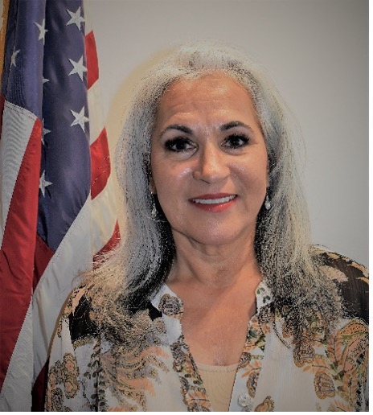
Guest Speaker Arizona SBA
Delia Castillo
United States Small Business Administration
Economic Development Specialist
Notes:
9

Slide 10
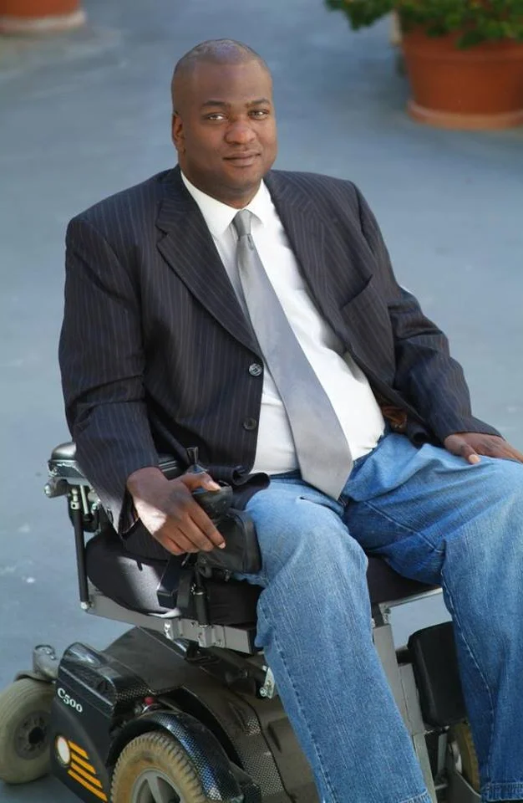
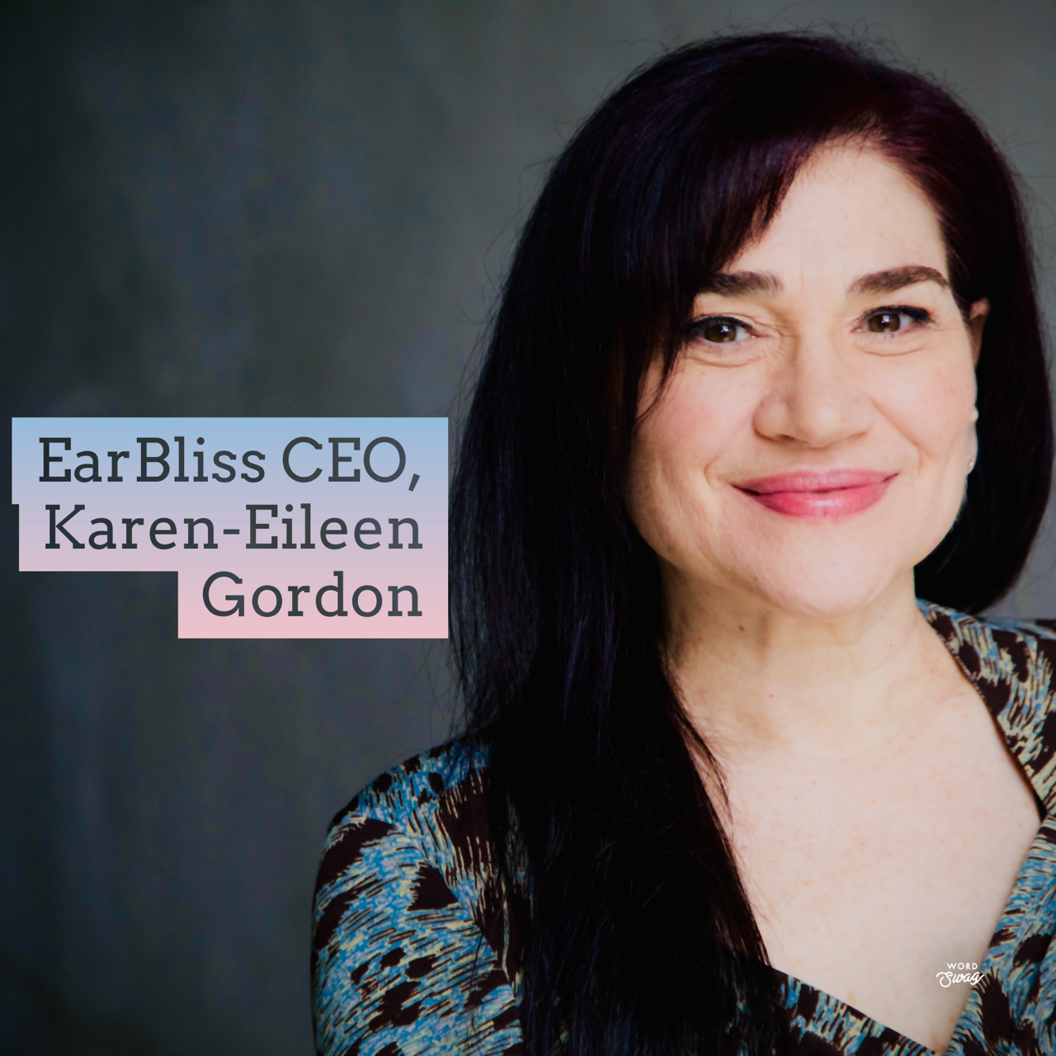
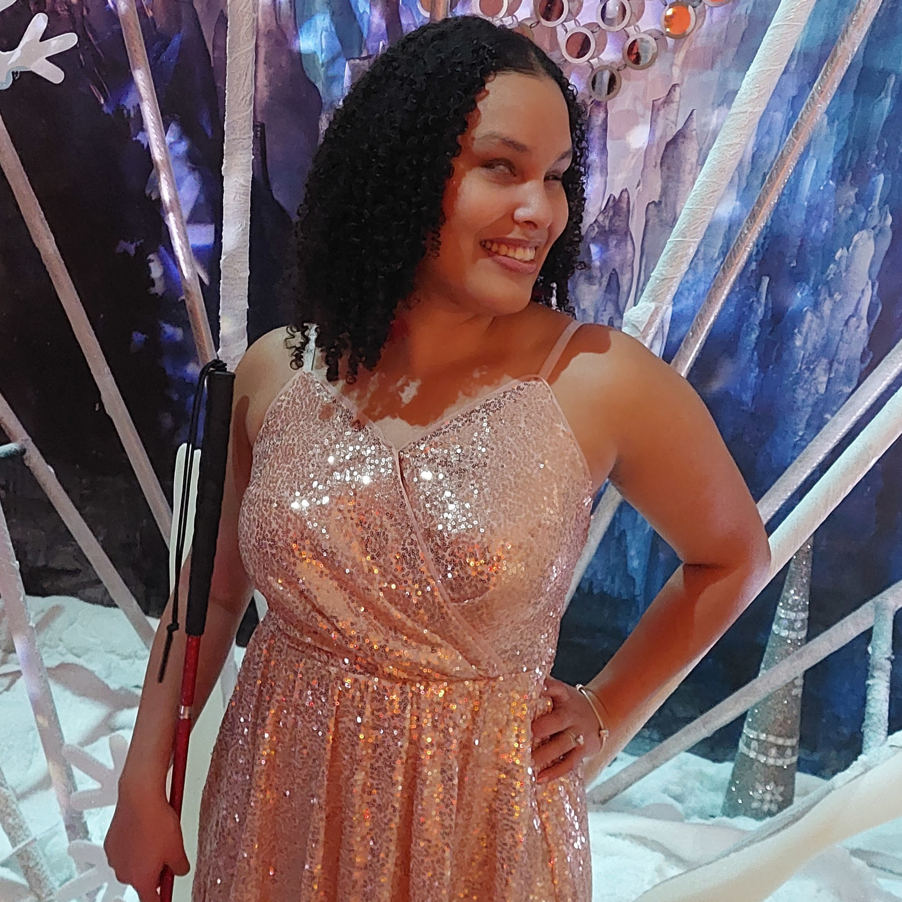
Entrepreneurship Panel
Karen-Eileen Gordon
CEO EarBliss| Actor | Radical Self Care for Entrepreneurs| Coach/Workshops |Keynote Speaker
Paul Amadeus Lane
Accessibility Consultant| TV & Radio Personality | Brand Ambassador| Keynote Speaker| MC
Precious Perez
Artist |Educator| Disability Advocate | VP at RAMPD
Notes:
10

Slide 11

KAREN-EILEEN GORDON
02
Wellness Expert
01
Entrepreneur ☺
Wellness has been a massive love since I was small…I’m a fan of (and highly trained in) multiple modalities: Mental Wellness Mindset Toolkits, Meditation, Anxiety Reduction, Energy Healing, Yoga and more. HUGE FAN of using wellness practices to boost careers.
Founder and CEO of EARBLISS™, a creative services company amplifying the Power of Voice: coaching, keynotes, 1:1 mentorship, workshops, webinars, voice/voiceover services.
03
VO Artist
Actor
04
10+ years in commercials, audiobooks, animation, video games; former Radio Producer for the Armed Forces Radio Network.
Film, Television, Stage, New Media…everything from Series Regular and Female Lead roles to one-person shows. SAG-AFTRA and AEA.
COPYRIGHT 2023 EARBLISS™ LLC – ALL RIGHTS RESERVED WORLDWIDE

Slide 12
I’d love to work with you
(all options ARE AVAIL AS group or 1:1 trainings)
1. RADICAL SELF-CARE FOR ENTREPRENEURS
2. PITCH PERFECT: AUTHENTIC Public speaking/presentation TOOLKIT
3. VOICEOVER 101: LAUNCH YOUR VOICEOVER CAREER
4. CREATE YOUR OWN CONTENT: CREATIVE WAYS TO BOOST YOUR BIZ VISIBILILTY
copyright 2023 – EarBliss LLC – all rights reserved worldwide

Slide 13


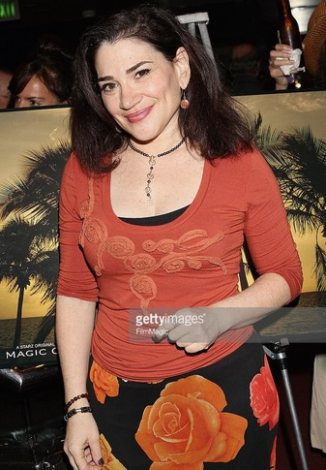
Reach out!
EarBlissCreative@GMAIL.COM
Karen-Eileen Gordon
copyright 2023 – EarBliss LLC – all rights reserved worldwide

Slide 14




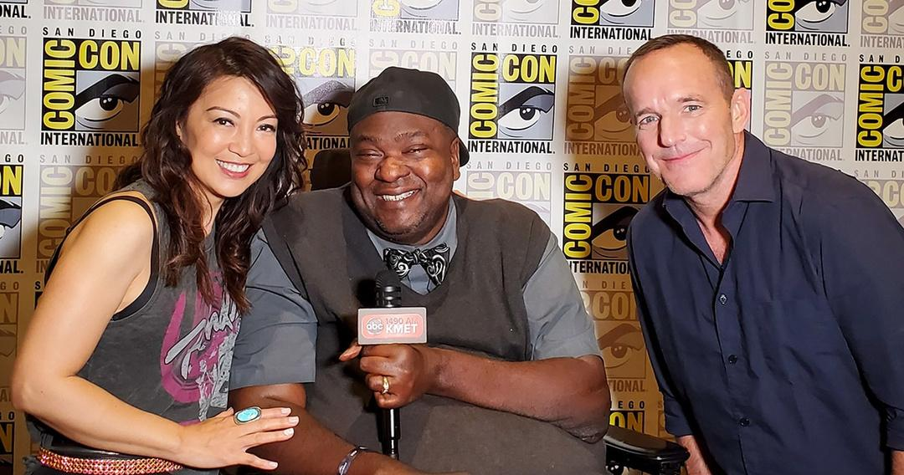

Paul Amadeus Lane
Who am I?
Entrepreneur
Gaming, Tech & Medical Accessibility Advisor Journalist – Content Creator – Brand Ambassador
C-6 Quadriplegic since 1993

Slide 15






Brands Worked With

Slide 16
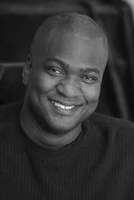

  Paul Amadeus Lane
Want to Connect?
www.Amadeus4thmedia.com
www.paulamadeuslane.com
Amadeus@paulamadeuslane.com
@paulamadeuslane

Slide 17
Precious Perez
Artist, Educator, and Disability Advocate, VP at RAMPD

Slide 18
About Me
Blind latina woman, dark curly hair
Professional music artist, CEO of Precious Perez Music LLC
Berklee grad, Double Bachelors degree in music ed and Performance
VP at RAMPD(Recording Artists and Music Professionals with Disabilities)
Recording Academy Member
Disability advocate, actress, and author

Slide 19
Why I Do What I Do
Music is my passion, but also a vehicle for social change/impact
Representation matters, creating space for all the communities I represent
Leave the world better than I found it
Giving back while doing what I love
Rampd is rampd.org
Precious Perez website: preciousperezmusica.com

Slide 20

Questions and Answers
Notes:
20

Slide 21
Resources
2Gether-International
https://www.2gether-international.org/
Disability small business start-up and accelerator program, holds virtual peer-to-peer support group meetings, workshops and career coaching while offering one-to-one mentoring opportunities and referral services to support entrepreneurs with disabilities. Visit website for application requirements.
Arizona@Work
https://arizonaatwork.com/
Arizona’s American Job Center has no-cost employment readiness services.
From their website you can research job market trends, wages by occupation, and other analytics to inform your business plan development.
Notes:
21

Slide 22
Resources
Job Accommodation Network JAN consultants handle inquiries related to self-employment and small business development for people with disabilities. This includes referrals regarding business planning, financing strategies, marketing research, disability-specific programs, income supports and benefits planning, e-commerce, independent contracting, home-based business options, and small business initiatives for disabled veterans.
https://askjan.org/topics/Entrepreneurship.cfm
U.S. Small Business Administration
https://www.sba.gov/business-guide
10 Steps to Starting Your Small Business Guide
Information on business plans, funding suggestions etc.
Notes:
22

Slide 23
Resources
Phoenix Women Business Center
https://phoenixwbc.org/
Provide counseling, training, business assistance and access to capital for women looking to grow or start their company.
Greater Phoenix SCORE
https://greaterphoenix.score.org/
On Demand Training, in person and virtual webinars, and access to mentorship to support in development of a business plan and starting a small business.
Arizona Small Business Development Center
https://azsbdc.net/how-we-help/
Ongoing resources and training for small business.
Notes:
23

Slide 24
Resources
DreamBuilder
www.dreambuilder.org
Free online learning program developed for women who want to start or grow their own business.
National Center for Disability Entrepreneurship
https://www.viscardicenter.org/entrepreneurship/
Program with curriculum for any person with a disability looking to launch or expand a business. Visit website to see if accepting new applications.
Disability Small Business Hub
https://www.disabilitysmallbusiness.org/
A collaboration between the National Disability Institute and the U.S. Small Business Administration. Provides current resources, podcasts, trainings, and events to start, build, and grow your small business.
Notes:
24

Slide 25
Resources
Securing Your Financial Future Toolkit www.dol.gov/agencies/ebsa/secure-your-financial-future The Securing Your Financial Future Toolkit was developed by U.S. Department of Labor’s Office of Disability Employment Policy (ODEP) and Employee Benefits Security Administration (EBSA). It’s a guide for people with disabilities who strive to obtain or maintain employment and achieve financial stability.
National Center for Disability Entrepreneurship
https://www.viscardicenter.org/entrepreneurship/
Program with curriculum for any person with a disability looking to launch or expand a business. Visit website to see if accepting new applications.
Notes:
25

Slide 26

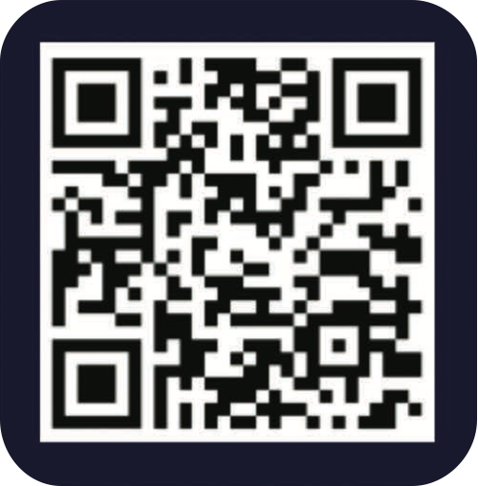
Use the QR code below to register for our next webinar on March 25:
Reach out to Ability360 or any of our presenters with follow-up questions.
Notes:
26

