Slide 1

Small Business and Entrepreneurship Options for People With Disabilities
A three-part webinar series
Part Three: Small Business and Entrepreneurship Funding and Financial Considerations
Presented by Bank of the West
Notes:
1

Slide 2
Housekeeping I: Captioning
If you wish to personalize the captioning:
We have sign language interpreters. You should be able to pin them to your screen.
Alternatively, Click the “Live Transcript” button on the Zoom panel to find the Hide Captions option,or adjust caption size under the “subtitle settings...” option.
Notes:
2

Slide 3

Housekeeping II: Questions
Content questions?
Click on the chat button and type in your question.
Tech support questions? Type your question in the Chat box.
Notes:
3

Slide 4


Welcome/ Into
Andy Arias Policy and DEIA Subject Matter Expert
Notes:
4

Slide 5

Learning Objectives
Participants will learn strategies to:
  Credit and pay day loans
  Challenges
  EN for Entrepreneurs
  Panel of Disability Service providers (WIPA , AHCCCS Freedom, ABLE, and VR)
Notes:
5

Slide 6

Ability 360 –Who We Are
April Reed, LMSW
Vice President of Advocacy
Notes:
6

Slide 7
Challenges- Concern of Loss of Public Benefits
Fear of Losing SSI, SSDI, Health Insurance
61% surveyed felt that the income generated from their business would affect their ability to obtain disability services.
Difficulty Accessing Needed Public Benefits
While 39% percent of participants felt they would not need help, another 45% percent felt they did need help but weren’t able to receive help. Only 16% indicated that they received assistance
Notes:
7

Slide 8
Challenges- Accessing Credit and other Financial Services
Access to Loans
40% of respondents indicated that they are uncomfortable taking out a loan due to their disability.
30% said they didn’t want a loan and 24% did not think their application would be approved for any type credit.
16% indicated they had sufficient funding and did not credit.
Others barriers: lack of assets, desire to protect assets, history of poor credit due to medical bills and bankruptcy, and overwhelming loan application process.
Notes:
8

Slide 9
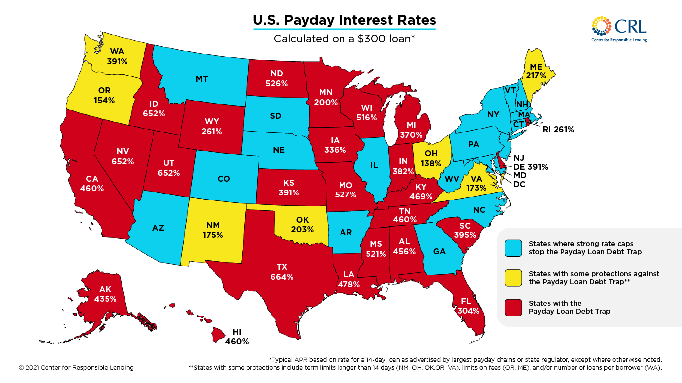
Pay Day Loans
Map of U.S. Payday Interest Rates
https://www.responsiblelending.org/research-publication/map-us-payday-interest-rates
Notes:
9

Slide 10
  EN for Entrepreneurs
Consumer Directed EN
The Consumer Directed Services (CDS) Employment Network (EN) model is defined in the Ticket to Work Program (Ticket Program) as an EN business model that shifts responsibility for key service decisions from the EN to the beneficiary. An EN operating under a CDS business model allows beneficiaries to make their own decisions regarding needed employment services and supports, and then subsequently assists those beneficiaries in paying for the services, either through direct payment to the vendor or cash reimbursement to the Ticketholder.
https://yourtickettowork.ssa.gov/employment-networks/consumer-directed-en.html
https://choosework.ssa.gov/
Notes:
10

Slide 11
Activity
What are the first steps for an entrepreneur's financial success?
Notes:
11

Slide 12
Managing Social Security Benefits & Self-Employment
Ivan Rivera - WIPA Program

Slide 13
Barriers to Self-Employment
Loss of healthcare benefits
Not understanding Social Security rules regarding self-employment
Lack of resources
Learning how work incentives can help you grow your business
Learning how to work, save money, and keep your benefits

Slide 14
Supplemental Security Income (SSI) Work Incentive
Gross monthly earned income:
  General Exclusion ($20)
  Earned Income Exclusion ($65)
  Remainder divided by 2 (2 for 1 Reduction)
  Countable Earnings
  Subtract Countable Earnings from SSI cash benefit
  Equals new SSI cash amount

Slide 15
Social Security Disability Insurance (SSDI) Work Incentives
9-Month Trial Work Period (TWP)
SGA & Cessation & Grace
36-Month Extended Period of Eligibility (EPE)
Impairment Related Work Expenses (IRWE)
Wage Subsidies and Special Conditions
Blind Work Expense (BWE)
Medicare Extension
Expedited Reinstatement

Slide 16
Self-Employment Income vs Wage Employment
Social Security refers to earned income of a self-employed individual as Net Earnings From Self-Employment (NESE)
Social Security treats self-employment income (SEI) differently than wages. Self-employed individuals need to calculate their net earnings from self-employment
Gross wages are used only when considering traditional employment income
IRS has numerous approved business expenses can be subtracted from gross receipts/earnings prior to the Social Security Tax deduction.

Slide 17
Work Incentive Planning & Assistance (WIPA)
The WIPA Program is a Benefits 2 Work (B2W) Arizona program managed by Ability360 that supports Social Security beneficiaries with disabilities in their transition to work
Community Work Incentive Coordinators (CWIC’s) are certified and trained to understand the rules and utilize the work incentives set forth by the Social Security Administration (SSA)
CWIC’s offer personalized services tailored to your specific situation and needs
These services are free for individuals that are receiving SSA disability benefits

Slide 18
Self-Employment Income
Development of profit and loss statements
Tracking your earnings and time spent on self-employment
How and when to file your taxes
How to and when to report your earnings to Social Security
We discuss different asset building accounts that can help you grow your business and save money

Slide 19

Enroll in WIPA Services
Consumers can call the Ticket to Work Helpline :
  866-968-7842 or log on to choosework.ssa.gov
Need More Help/Inquiries contact B2W directly:
  602-443-0720 or 1-866-304-WORK (9675)
  Email b2w@ability360.org
All B2W WIPA potential consumers will go through a centralized point of contact for initial request of services
Intake Specialist will fields all inquiries to assess what type of services the consumer needs as well
as their eligibility
This document is funded through a Social Security cooperative agreement.
Although Social Security reviewed this document for accuracy, it does not constitute an Official Social
Security communication. We developed this presentation at U.S. taxpayer expense

Slide 20
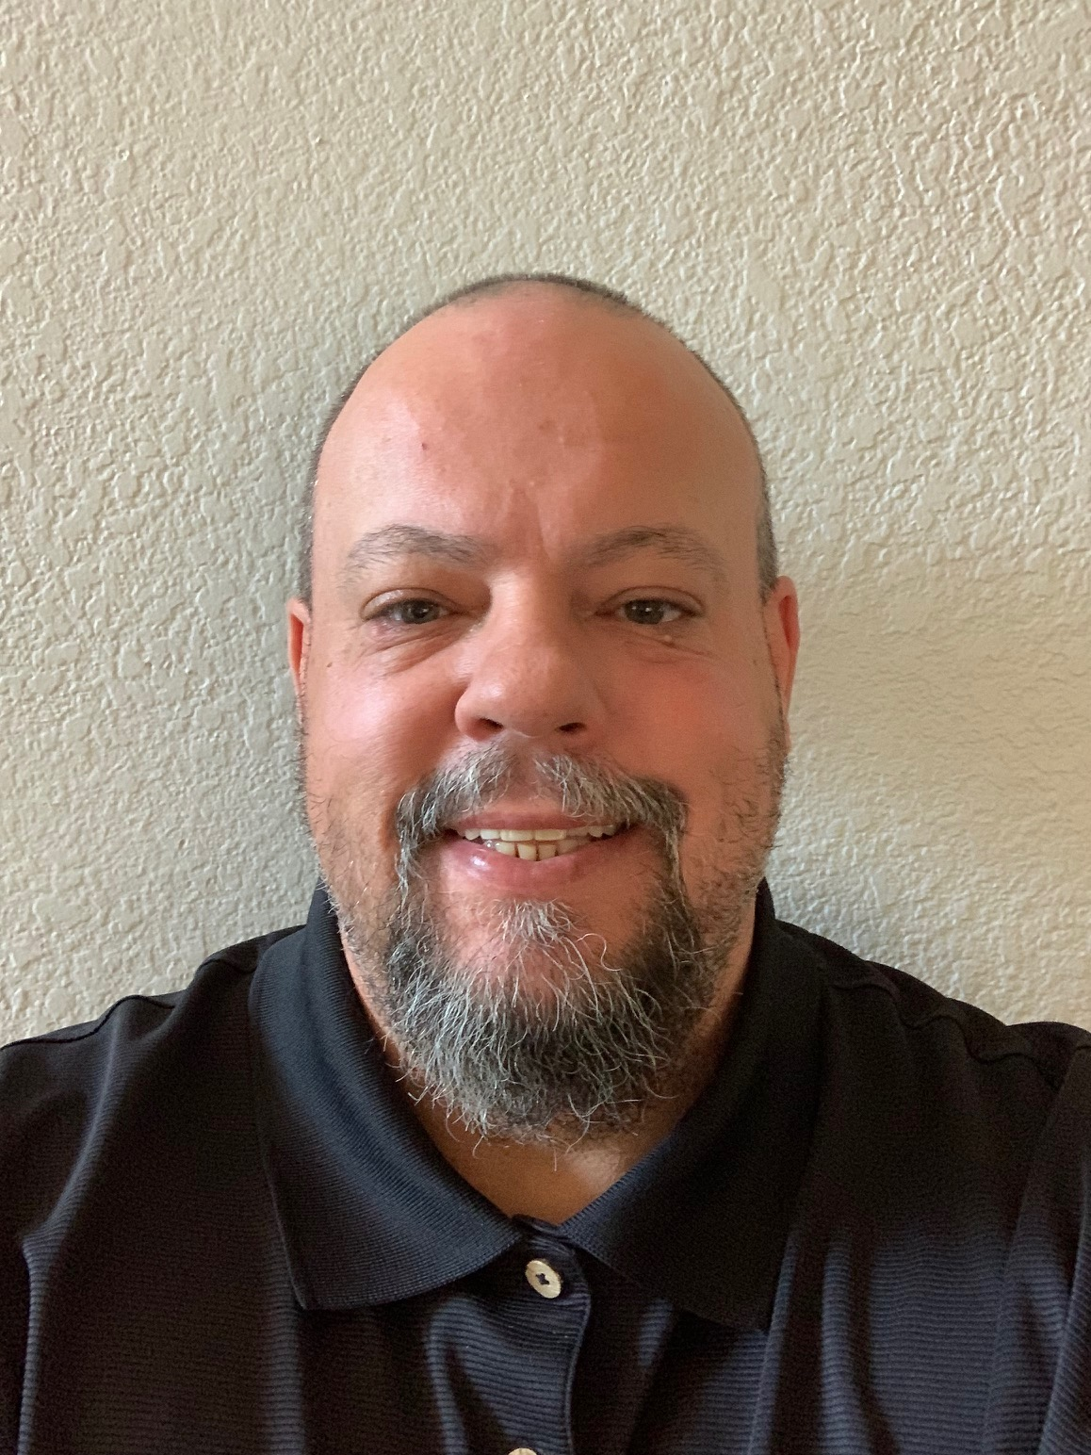
Adam Robson Employment Administrator

Slide 21
AHCCCS Freedom to Work Program – 2023

Slide 22

What is AHCCCS Freedom to Work?
AHCCCS Freedom to Work is affordable health insurance for individuals with disabilities who are EMPLOYED.
The program is provided by the State of Arizona and is managed by the Arizona Health Care Cost Containment System (AHCCCS).

Slide 23
What Does it Cover?
Program coverage includes:
Doctor’s Visits
Specialist Care
Hospital Services
Emergency Care
Surgery
Prescriptions
Behavioral Health Services
Laboratory and X-ray Services
Family Planning Services
Long term care services such as attendant care, assisted living home, or in-home services if eligible for the Arizona Long Term Care System (ALTCS)

Slide 24

How Do I Qualify?
***The AHCCCS Eligibility Policy for Freedom to Work is on the AHCCCS website
The conditions of the FTW program eligibility are:
Complete a valid application
Age 16 to 64 and a resident of Arizona
Provide or apply for a valid Social Security number
US citizen or appropriate non-citizen status
Not incarcerated
Apply for potential benefits (e.g., cash benefits)
Assignment of rights to medical benefits and cooperation (disclosure of other health benefits);
Meet the Basic Coverage Group or Medically Improved Coverage Group definitions for disability
  You are receiving SSDI or SSI; or
  You have been determined to have a disability by the Disability Determination Services Administration (DDSA); or
  You have been determined medically eligible for ALTCS
Only about half of your earnings will be used as your monthly countable income
Assets are not counted when determining eligibility

Slide 25
How Do I Qualify?
***The AHCCCS Eligibility Policy around Freedom to Work in on the AHCCCS website
(Continued)
Employed and paying taxes;
Monthly countable income under 250% FPL (under $3,038 per month);
  See next slide for more information
Pay the AHCCCS FTW premium, if required; and
Not eligible for any other Medicaid program
Also…
FTW is your last resort
May find out you are eligible for other Medicaid programs when applying for FTW
Only the customer’s earned income is used to determine eligibility for FTW. Unearned income, such as Social Security, is not counted in the FTW calculation.
You can see if you’re potentially eligible for FTW on the DB101 website https://az.db101.org/planning/.

Slide 26
What is Countable Monthly Earned Income?
Step | Action
1 | For the income eligibility determination, disregard all unearned income received by the customer.
2 | To calculate the net earned income: The counted earned income of the customer is totaled; and The following are subtracted in this order: Student Earned Income Exclusion (only if under age 22); The $20.00 general income deduction; The $65.00 work expense deduction; Impairment Related Work Expenses; ½ of subtotal of earned income; and Blind Work Expenses.
3 | The result in Step 2 is compared to 250% of the FPL: The customer passes the income test if the net income is less than or equal to the income limit.

Slide 27
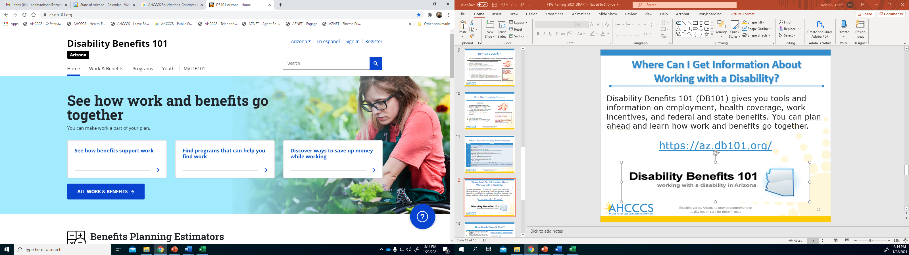
Where Can I Get Information About
Working with a Disability?
Disability Benefits 101 (DB101) gives you tools and information on employment, health coverage, work incentives, and federal and state benefits. Plan ahead and learn how work and benefits go together. https://az.db101.org/

Slide 28
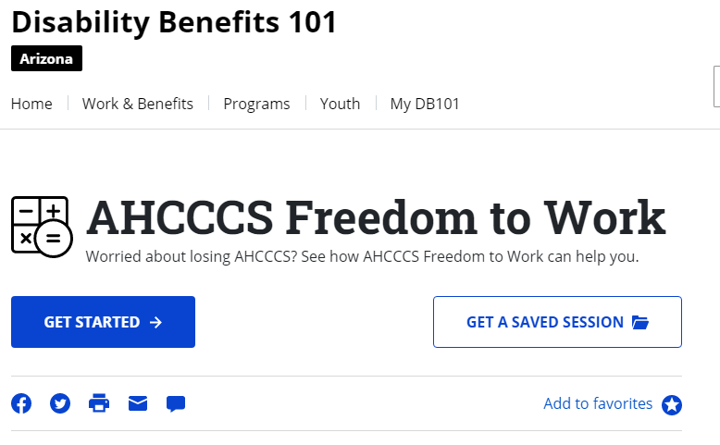
How Much Does it Cost?
Monthly premiums range from $0 to $35 depending on the amount of your countable earned income.
To determine if eligible and/or find out how much your premium may be, try the Freedom to Work Estimator on the DB101 website. Please note that the amount on DB101 is an estimate and the exact amount would be determined by AHCCCS, based on different variables.
Please Note: The DB101 Estimator tool for FTW is not an official AHCCCS tool but can be used as a guide.
https://az.db101.org/planning/

Slide 29

How to Apply
To apply online, visit Health-e-Arizona at https://www.healthearizonaplus.gov.
Health-e-Arizona lets you apply for other programs, like Nutrition Assistance or TANF Cash Assistance, at the same time.
  If you need additional assistance or have questions, call: 855-HEA-PLUS (855-432-7587)
OR
For a paper application, please visit: https://www.azahcccs.gov/Members/GetCovered/apply.html
Best practice is to submit at least one full month of check stubs.
Applicants who are self-employed must submit:
  Copies of current Federal tax returns; or
  Proof of business income and expenses

Slide 30

Thank You
Adam Robson
Employment Administrator
AHCCCS
Adam.Robson@azahcccs.gov

Slide 31

Brittaney M. Chipley AZ ABLE Executive Director
Notes:
31

Slide 32
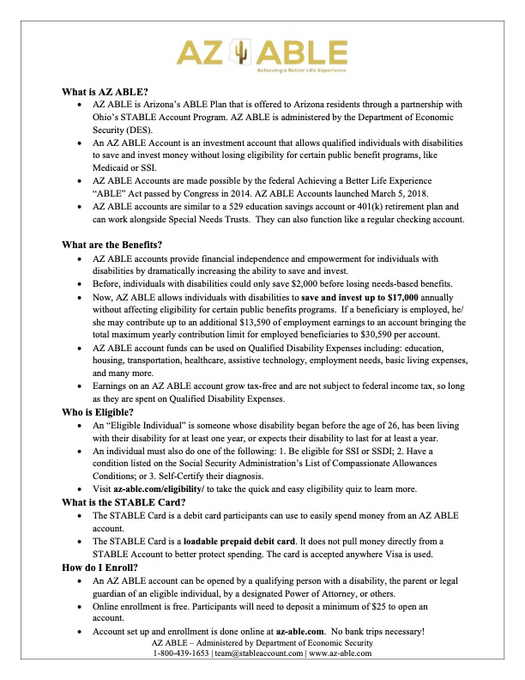
Notes:
32

Slide 33

Vocational Rehabilitation
Self-Employment
Notes:
AZ VR representative, Jami Parente

Slide 34
Self employment considerations:
Self Employment is not an employment goal
  It is an employment setting
Hobby ventures v. business ventures
Disability related need for self-employment venture
Intermediate objectives:
  Career exploration to include labor market survey, informational interviewing, and shadowing
  Supported education to explore training
    Subject matter
    Entrepreneurship training (required)
    Business classes—must be comprehensive in nature
  Complete a proposed business concept overview
    Small Business Consultation
    Note: VR will not fund services that actually create a business or contribute to an existing business during this stage

Slide 35
Self employment considerations:
When small business concept overview is approved:
Intermediate objectives:
  Complete required trainings
    Subject matter and business operations
  Business Plan Development
  Small Business Consultation Business Plan Consultation
  Business Plan Development
    Only for clients who have extreme difficulties due to nature of disability

Slide 36
Self-Employment Plan approval
Approval by Program Supervisor and/or Assistant Program Manager
  Up to $5,000 only
  Can refer to SERC if Program Supervisor or APM feel it is in the best interest of program and client
Approval by Self-Employment Review Committee (SERC)
  Any amount up to $18,000

Slide 37
Self-Employment Plan approval
Business Plan must include:
  Executive Summary, Business Description, Marketing Plan, Operations Plan, and Financial Plan
  Business Financials Estimates (total start-up/operating costs estimates, item descriptions, purpose, cost per unit, source)
  Business Funding Summary (start up costs broken down by funding summary)
    All comparable benefits/other funding sources must be included and will be explored prior to using VR Funds
  Income statement for first two years-total sales, cost of goods sold, gross profit, business expenses, pre-tax profit/loss, taxes, net profit/loss
  If existing business-last 6 months of financials are required

Slide 38
Policy considerations/Requirements
Allowable
Non-Allowable
Start up costs to not exceed 6 month’s worth
Economic need
  If client does not meet, must provide 10% contribution
Individual must own at least 51% of business if in partnership
Cash
Labor costs
Replenishment of items
Replacement of equipment
Franchises/MLM/Pyramid Marketing
Items not allowed under Federal law

Slide 39

Questions and Answers
Notes:
39

Slide 40
Resources
2Gether-International
https://www.2gether-international.org/
Disability small business start-up and accelerator program, holds virtual peer-to-peer support group meetings, workshops and career coaching while offering one-to-one mentoring opportunities and referral services to support entrepreneurs with disabilities. Visit website for application requirements.
Arizona@Work
https://arizonaatwork.com/
Arizona’s American Job Center has no-cost employment readiness services.
From their website you can research job market trends, wages by occupation, and other analytics to inform your business plan development.
Notes:
40

Slide 41
Resources
Job Accommodation Network JAN consultants handle inquiries related to self-employment and small business development for people with disabilities. This includes referrals regarding business planning, financing strategies, marketing research, disability-specific programs, income supports and benefits planning, e-commerce, independent contracting, home-based business options, and small business initiatives for disabled veterans.
https://askjan.org/topics/Entrepreneurship.cfm
U.S. Small Business Administration
https://www.sba.gov/business-guide
10 Steps to Starting Your Small Business Guide
Information on business plans, funding suggestions etc.
Notes:
41

Slide 42
Resources
Phoenix Women Business Center
https://phoenixwbc.org/
Provide counseling, training, business assistance and access to capital for women looking to grow or start their company.
Greater Phoenix SCORE
https://greaterphoenix.score.org/
On Demand Training, in person and virtual webinars, and access to mentorship to support in development of a business plan and starting a small business.
Arizona Small Business Development Center
https://azsbdc.net/how-we-help/
Ongoing resources and training for small business.
Notes:
42

Slide 43
Resources
DreamBuilder
www.dreambuilder.org
Free online learning program developed for women who want to start or grow their own business.
National Center for Disability Entrepreneurship
https://www.viscardicenter.org/entrepreneurship/
Program with curriculum for any person with a disability looking to launch or expand a business. Visit website to see if accepting new applications.
Disability Small Business Hub
https://www.disabilitysmallbusiness.org/
A collaboration between the National Disability Institute and the U.S. Small Business Administration. Provides current resources, podcasts, trainings, and events to start, build, and grow your small business.
Notes:
43

Slide 44
Resources
Securing Your Financial Future Toolkit www.dol.gov/agencies/ebsa/secure-your-financial-future The Securing Your Financial Future Toolkit was developed by U.S. Department of Labor’s Office of Disability Employment Policy (ODEP) and Employee Benefits Security Administration (EBSA). It’s a guide for people with disabilities who strive to obtain or maintain employment and achieve financial stability.
National Center for Disability Entrepreneurship
https://www.viscardicenter.org/entrepreneurship/
Program with curriculum for any person with a disability looking to launch or expand a business. Visit website to see if accepting new applications.
Notes:
44

Slide 45

Reach out to Ability360 or any of our presenters with follow-up questions.
Notes:
45

